Slide 1

Airline Customer Satisfaction Prediction
You'll Want to Fly with us Again!
Scientology

Slide 2

Scientology
We are a group of data consultant.
In this project, We were hired by
an X airline company to consult
about their company performance
and requested us to assess their
flight service.
Managed by : Ade Irawan
Our data scientist team consists of :
M. Rafi Daniswara
Danang Putra R
Achmad Auzan Z
Catur Pratama R
Mohammad Ali

Slide 3
CONTENTS
Problem Statment
01
About main problem, objectives, metrics, goals in this project
02
EDA & FEATURE SELECTION
That we used for the project
03
Insights
Knowledge that we found along the way
04
Modelling & Recomendation
That we used to deliver the goals of the project.
Scientology

Slide 4


PROBLEM STATEMENT
Scientology
X Airlane is an airline that have great demand by the public with various flight classes and destinations. Every customer who has used X Airlane services is given the opportunity to give the assessment with class and purpose of traveling as identifier.
In 2020 X Airlane evaluates the assessment of the services they have provided. From 100% of the ratings, 45% of cutomers are dissatisfied with the services that have been provided and focused on customer satisfaction, the business team wants to know which services have a great impact on customer satisfaction so that it can be improved optimally and X Airlanes can always provide the best service.
In this case, Scientology plays a role in analyzing the results of the evaluation and providing solutions related to the X Airlane problem and can predict the satisfaction in the future.
OBJECTIVES
Predict the satisfaction for airline’s future Customers.
Determine which features that impactful to the satisfaction.
Create an accurate model for the given case.
METRICS
Satisfaction level
Average Rating.
GOALS
Found features that strongly affect the customer’s satisfaction.
Satisfaction level rise by 10%
Increased average rating by 0.1

Slide 5
DATA SET
Scientology
DATA SET
DATA RATING
129.880
Raw data
1 Column
TARGET
23 Columns
FEATURE
14 Columns
3,3
AVG Rating
RATING
Scaled 1 – 5
Representing customer
experience with the service
The Target Percentage
The target classes are rather
balanced with 54.7 %
of Satisfied and 45.3%
reporting Dissatisfied .

Slide 6

EDA & FEATURE SELECTION
PASSENGER SEGMENTATION
We group targets by Travel destination and flight class. It can be seen that passengers traveling for
business purposes are more satisfied than personal travelers.
On the flight class chart, many passengers travel in Business class and are also comparatively more
satisfied than customers traveling in economy or economy plus. We chose to deepdive economy class because it has more dissatisfied ratings than satisfied.

Slide 7
EDA & FEATURE SELECTION
Scientology
???

Slide 8
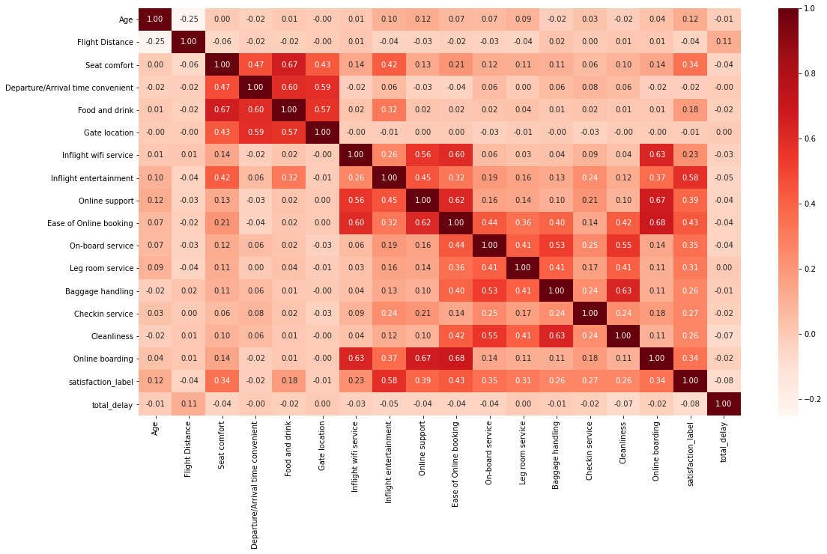
EDA & FEATURE SELECTION
Scientology
Heatmap Corelation
Features with highest
correlation points :
Inflight Entertainment
Online Support
Ease of Online Booking
On-Board Service
Seat Comfort
Online boarding

Slide 9
EDA & FEATURE SELECTION
Scientology
Heatmap Corelation
Features with Low
correlation points :
Flight Distance,
Departure/Arrival time convenient
Gate location,
Total_Delay

Slide 10
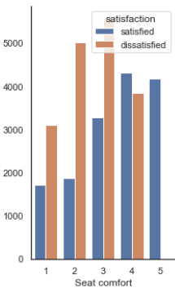
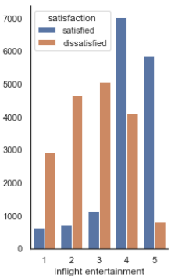
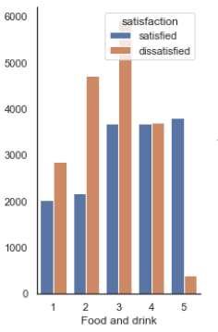
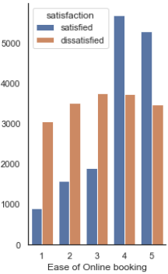
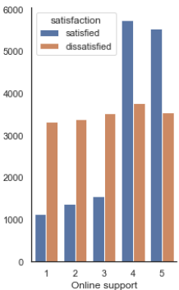
INSIGHT
Scientology
VISUAL BASED ON PERSONAL TRAVELLER
Pada Personal Traveller, ratting terendah terdapat pada feature : Seat Comfort, Food and Drink, Inflight Entertaintment, online support, ease of online booking

Slide 11
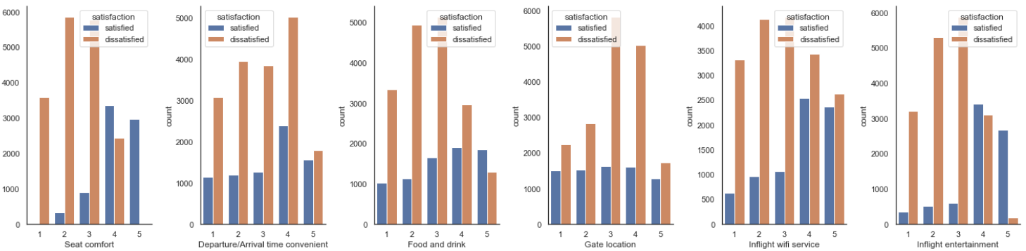
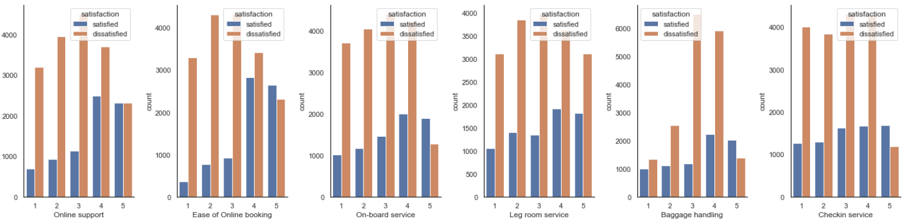
INSIGHT
Scientology
Pada Business Traveller, ratting terendah terdapat pada feature : Seat Comfort, Food and Drink, Inflight Entertaintment, Gate Location, Inflight wifi Service, online support, ease of online booking, On-Board Service, Leg room Service, Baggage Handling, Checkin Service, Cleanliness dan Online Boarding.

Slide 12
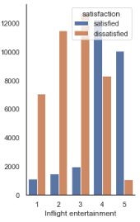
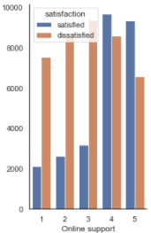
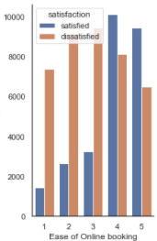
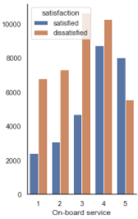
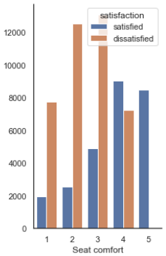
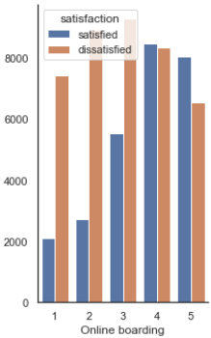
INSIGHT
Scientology
So based on the heatmap, Scientology can inform that there are 6 features that are mutually
correlated but have the most dissatisfied rating :
Inflight Entertainment
Online Support
Ease of Online Booking
On-Board Service
Seat Comfort
Online boarding

Slide 13
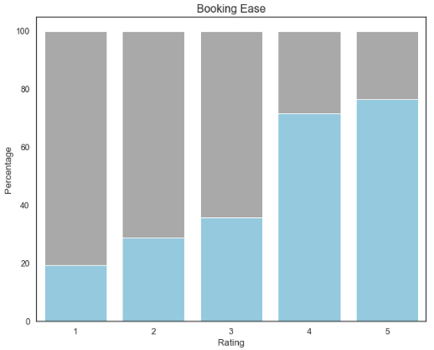
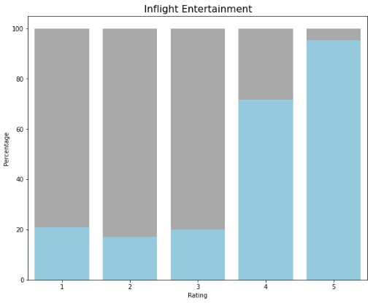
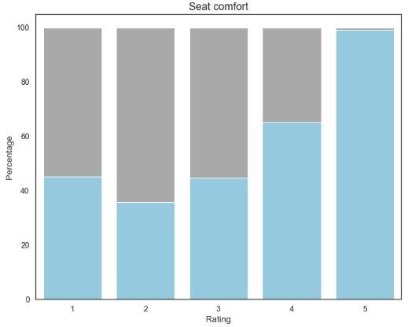
INSIGHT
Scientology
Besides heatmap, also based on our detailed EDA, we found there are several services that giving a significant value of satisfied customer in their rating value of 5. Those top 3 rating were Inflight Entertainment, Seat comfort, & Ease of Online booking.
We figured their causality towards satisfaction level by bringing up their satisfaction probability.
From the plot we can see drastic changes on satisfaction probability from rating 3 to 5.

Slide 14
EDA & FEATURE SELECTION
Scientology
PROCESSING & FEATURE ENGINEERING
01
Null data will be dropped
02
The "Ratings" feature is tweaked, the value 0 is replaced by mode value
03
Normalization of 'Age', 'Flight Distance', & 'Total Delay' features
04
Outliers eliminated by IQR
05
One-hot encode on 'Gender', 'Customer Type', 'Class', & 'Type of Travel' features

Slide 15
MODELLING
Scientology
Model Algorithm
Logistic Regression
Decision Tree
K-Nearest Neighbors
RandomForest
XGBoost
Evaluation Metrics
F1 Score

Slide 16
MODELLING
Scientology
The F1 score on both RF and XGBoost are equal, we chose RF because we want our model undisturbed with weighted scheme of boosting methods

Slide 17
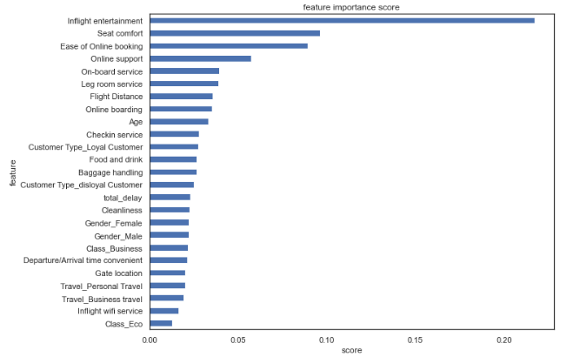
MODELLING
Scientology
Feature Important
From the Random Forest model, We found that top 3 feature that most important for the model were :
Inflight Entertainment
Seat comfort
Ease of Online Booking

Slide 18
BUSSINES RECOMMENDATION
Scientology
Based on RandomForest model, Scientology highly recommended for business team to focus optimizing on this 3 services :
Seat Comfort :
rejuvenating the airplane seat, replacing it with a more ergonomic bench model and
paying attention to body posture when sitting.
Inflight Entertainment :
support output like Headset, monitor and periodically update the options existing
entertainment such as movies, music or other media services.
Ease of online booking :
create an easy-to-understand interface so that users don't feel bothered and does
not take time when making a booking.

Slide 19
Impact Simulation
Scientology
11% Satisfcation level increase
0.3% Satisfcation level decrease
Services | Current Rating | Random Rating | Eco-Focused & General Rating
Inflight Entertainment | 1 – 5 | 1 – 5 | 4/5
Seat comfort | 1 – 5 | 1 – 5 | 4/5
Ease of Online booking | 1 – 5 | 1 – 5 | 4/5
Departure/Arrival Time Convenient | 1 – 5 | 4/5 | 1 – 5
Gate location | 1 – 5 | 4/5 | 1 – 5
Inflight wifi service | 1 – 5 | 4/5 | 1 - 5
Avg. Rating Overall | 3.3 | 3.4 | 3.4
15.5% Satisfcation level increase
*Jumlah Penumpang Pesawat Indonesia 2021
Notes:
Dengan asumsi per hari jumlah customer sebanyak 10.000 penumpang, hanya membutuhkan 1 minggu untuk mendapatkan peningkatan >15% jika menerapkan bisnis rekomendasi yang telah disebutkan.
General Implementation: Business Recommendation di apply terhadap semua jenis kelas secara acak
Random Implementation: Jika service yang ditingkatkan tidak sesuai sepert Business Recommendation
Eco-Focused Implemetation: Business Recommendation di apply terhadap kelas Eco & Eco Plus saja

Slide 20
THANK YOU

